Slide 1
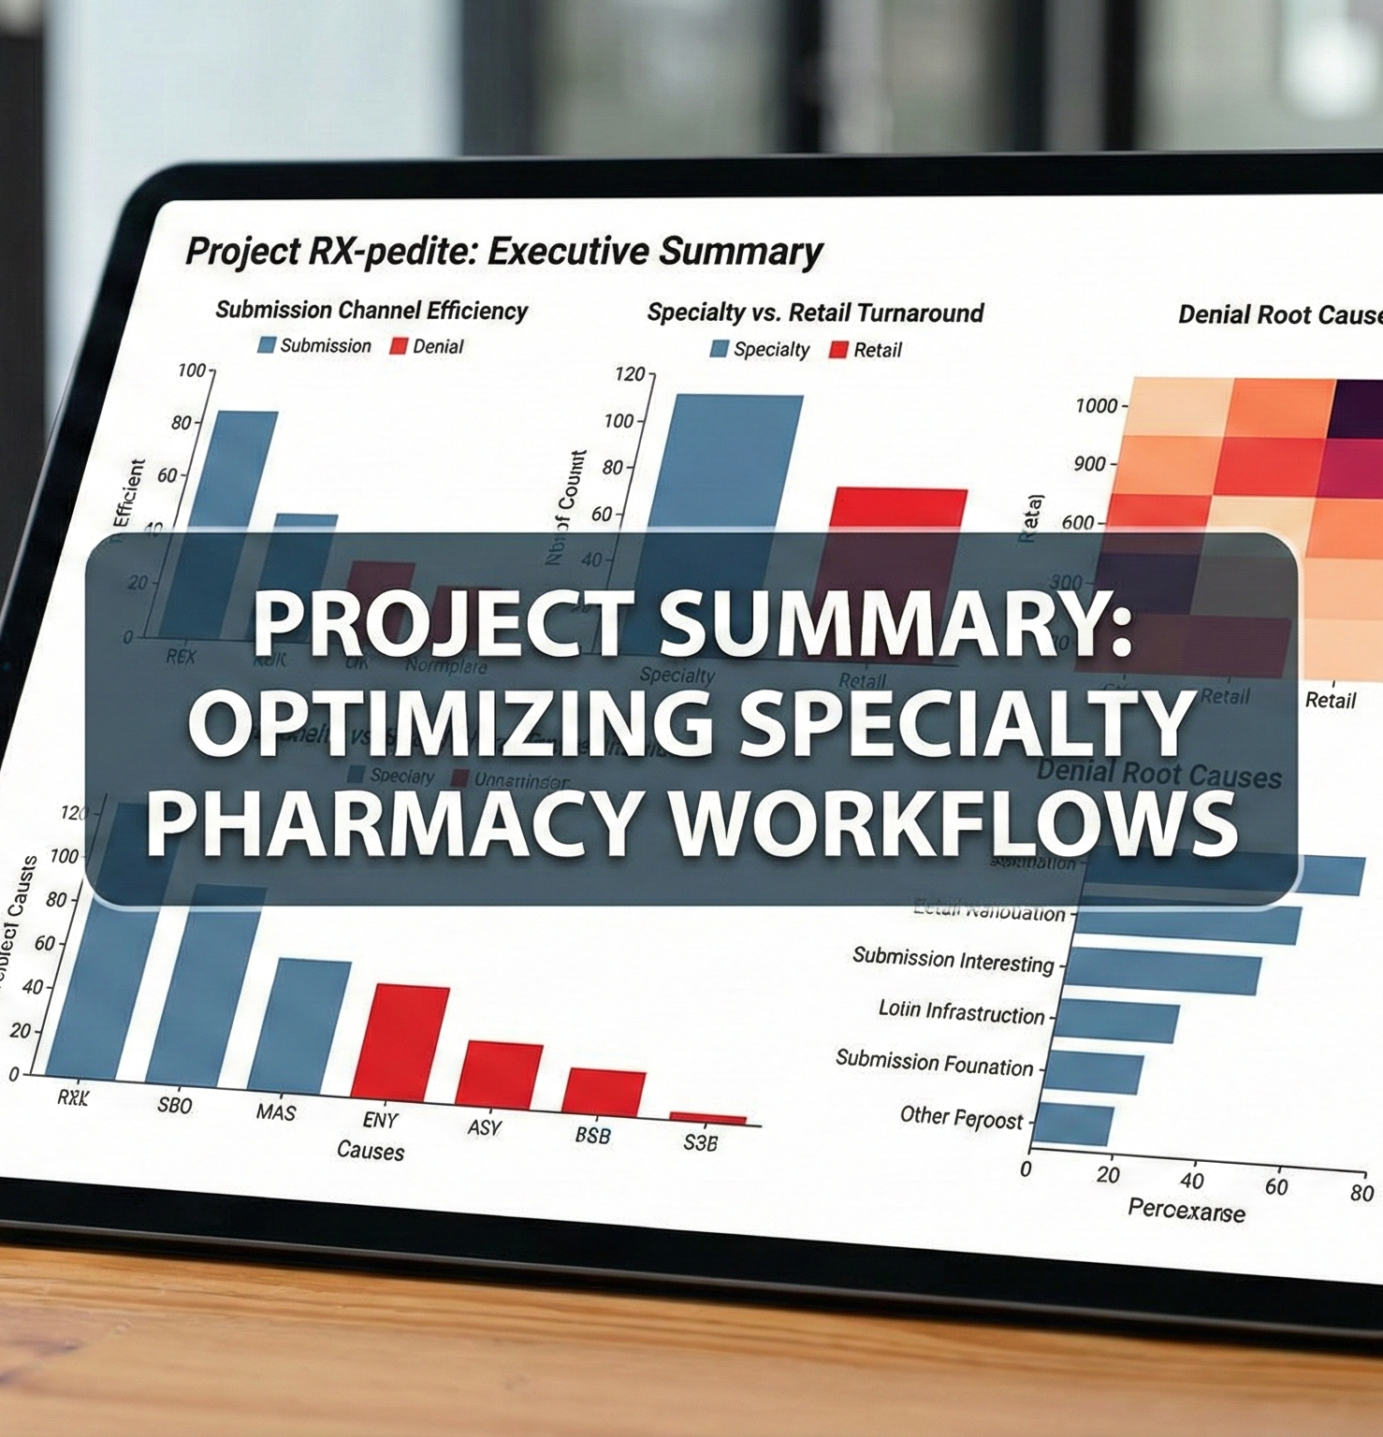
Project RX-pedite
Accelerating Speed-to-Therapy
Project RX-pedite audits thousands of Prior Authorization records to speed up patient access to critical therapies.
Eliminating Workflow Bottlenecks
Legacy manual processes hide digital efficiency and slow down care. The audit seeks to identify and remove these obstacles.
Addressing the 'Fax Tax'
Reducing the 141% 'Fax Tax' optimizes specialty pharmacy operations and ensures faster therapy delivery to patients.
Notes:
"Thank you for joining me today. My name is Sean Patrick Ryan, and I’m excited to present Project RX-pedite. This was a strategic diagnostic audit I conducted on over 10,000 Prior Authorization records. My primary objective was to find out why some patients were waiting days longer for life-altering medications than others. What I discovered was a hidden bottleneck I’ve termed the '141% Fax Tax'—a massive administrative friction point that we can eliminate through digital migration and automation."

Slide 2
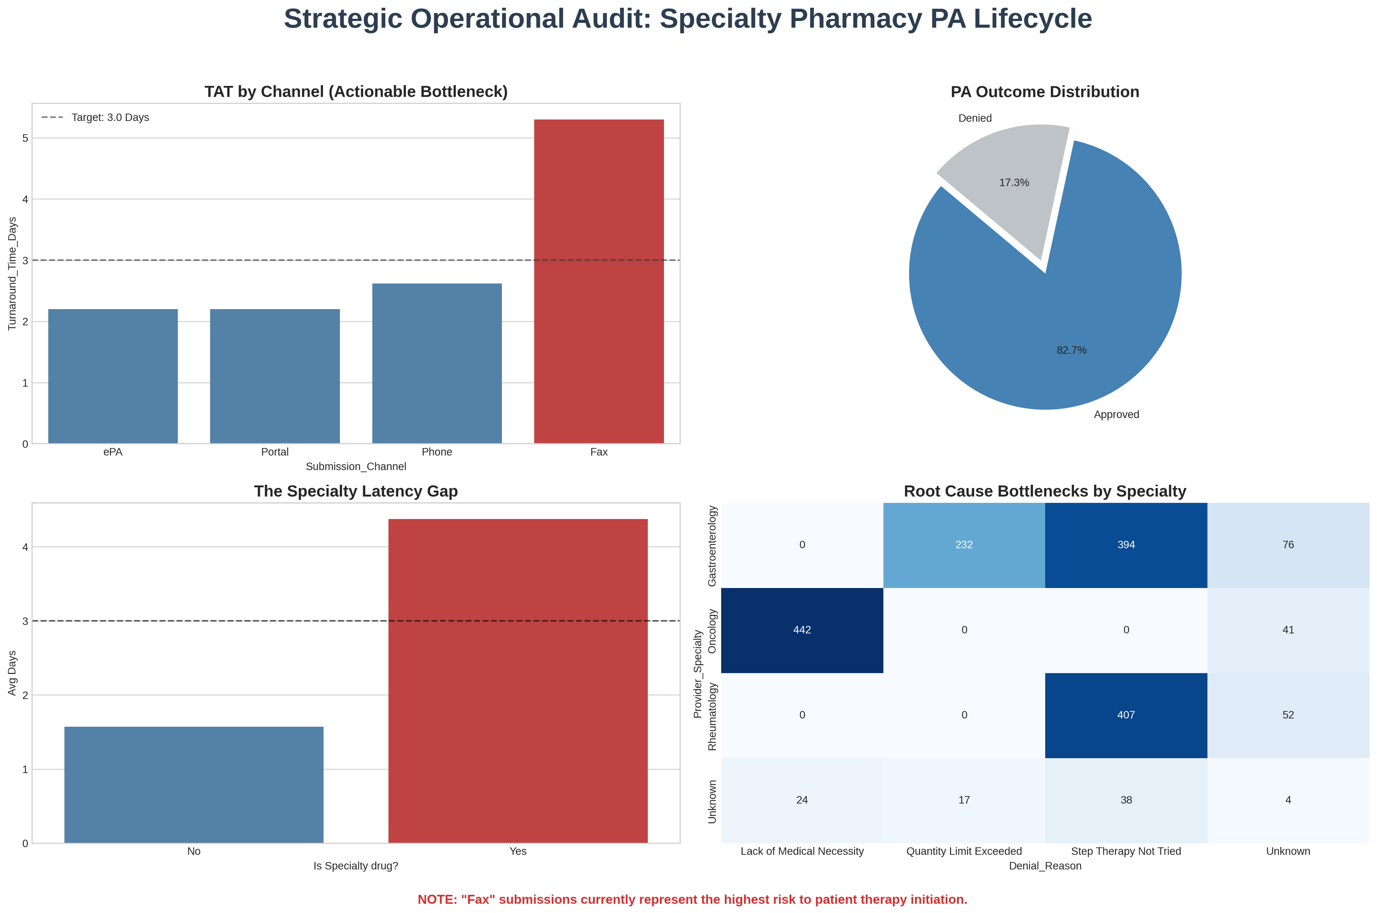
Quantifying Administrative Friction
Fax Submission Slows Processes
Manual fax submissions are significantly slower than electronic channels, causing major administrative delays and friction.
Turnaround Time Meets Target
Despite friction, the network maintains a 2.8-day turnaround, meeting the 3.0-day goal for prior authorizations.
Fax Tax Hinders Scalability
The 'Fax Tax' is a major barrier to achieving faster therapy, posing risks for scalability and operational efficiency.
Operational Improvement Needed
Addressing fax latency is crucial for improving operational efficiency and achieving faster therapy times.
Notes:
"To ensure the integrity of my findings, I followed the Google Data Analytics Lifecycle. A major part of this project was the 'Process' phase. Clinical data is notoriously messy; I had to standardize fragmented naming conventions—for example, merging records for 'Gastro' and 'Gastroenterology'—to get an accurate view of our high-volume specialties. By cleaning this data first, I was able to isolate the friction points specifically within the Rheumatology and GI categories, where delays have the highest clinical impact."

Slide 3
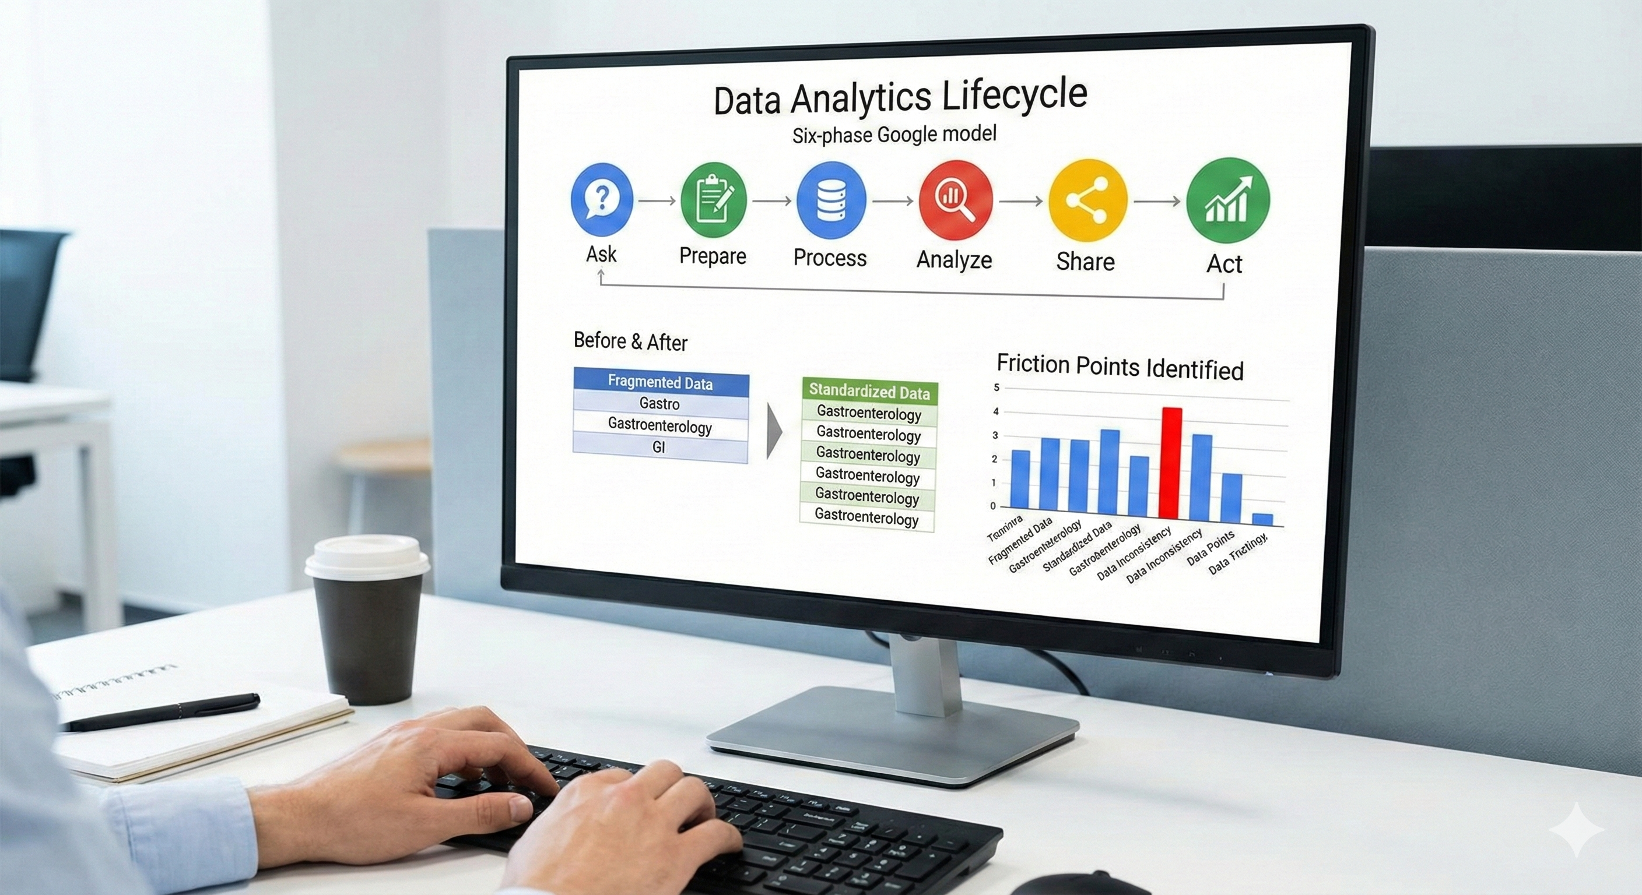
Detective Mindset in Action
Data Analytics Lifecycle
Applied the six-phase Google Data Analytics lifecycle, guiding the data cleaning process with systematic steps from asking to acting.
Standardizing Clinical Data
Standardized fragmented clinical naming, like unifying 'Gastro' and 'Gastroenterology,' to ensure dataset consistency and clarity.
Identifying Friction Points
Focused on biologic categories, uncovering hidden friction points and improving dataset integrity through meticulous cleaning.
Notes:
"This is the core of my analysis. If you look at the primary chart, you’ll see that while the network is technically meeting its 3.0-day turnaround target at 2.8 days, that average is misleading. When we segment the data by submission channel, we see the 'Smoking Gun.' Manual fax submissions are 141% slower than our digital ePA channels. This 'Fax Tax' isn't just a number; it represents thousands of hours of manual labor and unnecessary waiting for patients. This dashboard gives us the clarity to move from guessing where the delay is to knowing exactly where to intervene."

Slide 4

A 3-Tier Strategic Roadmap
Immediate Migration to ePA
Transitioning high-volume 'Fax-only' providers to electronic prior authorization saves 1,200 staff hours annually and boosts efficiency.
Automated Clinical Gating
Introducing automated Step-Therapy logic reduces manual nurse reviews by 15%, streamlining clinical decision-making.
Gold Carding for Auto-Approval
Piloting Gold Carding enables instant approval for top-tier partners, ensuring therapy begins in under 24 hours.
Notes:
"I don't just want to identify the problem; I want to solve it. I’ve developed a 3-tier roadmap to address this. Tier 1 is an immediate digital migration pilot for our high-faxing providers, which will reclaim 1,200 annual staff hours. Tier 2 involves implementing automated 'Step Therapy' logic at the point of submission to deflect simple clinical denials. Finally, Tier 3 is a Gold Carding program for our top-tier clinical partners, allowing us to hit a best-in-class sub-24-hour speed-to-therapy goal for our most compliant providers."

Slide 5
Scaling for Market Leadership
Maximize Digital Adoption
Achieving over 90% digital adoption improves operational efficiency and enables scaling without adding more personnel.
Reduce Latency Gap
Eliminating the 141% latency gap boosts patient adherence and enhances long-term health outcomes.
Automate Manual Processing
Digital automation cuts manual processing time from 2.8 days to less than 1 day, enabling market leadership.
Notes:
"The bottom line is scalability. By shifting to a 90% digital adoption rate, we can scale our volume without a proportional increase in headcount. More importantly, we reduce the window for therapy abandonment. We have the chance to move this organization from a 'Target-Meeting' state to a 'Market-Leading' state. I’m eager to bring this same level of diagnostic rigor and strategic thinking to the team. Thank you for your time, and I’m happy to take any questions."

